Slide 1
Virtual Environment
Sequences types: Lists, Tuples, and Strings
Mutability Vs Immutability
Git hub

Slide 2
Virtual Environment
virtual Env commands:
pip install virtualenv --package allows us to create virtual environment
virtualenv env ---creates virtual environment
env \Scripts\activate.bat --it activates virtual environment
Now check the pip list ---to check the number of environments
pip install django
Pipenv:
Pipenv which is now the officially recommended Python packaging tool.
pip install pipenv
pipenv shell ---to activate the command

Slide 3
Git Commands
git commands:
download git
Clone the project
git clone -b branchname https://github.com/vinodreddem/PythonPractice.git
without branch name master branch will get pushed
git status
git diff
git add .
git commit -m "commit messege"
git push origin master

Slide 4
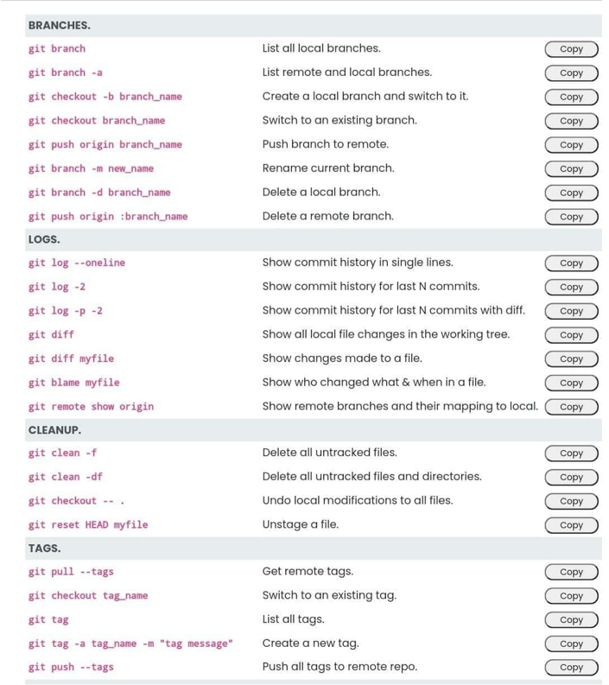

Slide 5
Sequence types: Tuples, Lists, and Strings

Slide 6
Sequence Types
Tuple: (‘john’, 32, [CMSC])
A simple immutable ordered sequence of items
Items can be of mixed types, including collection types
Strings: “John Smith”
Immutable
Conceptually very much like a tuple
List: [1, 2, ‘john’, (‘up’, ‘down’)]
Mutable ordered sequence of items of mixed types

Slide 7
Sequence Types
Tuple: (‘john’, 32, [CMSC])
A simple immutable ordered sequence of items
Items can be of mixed types, including collection types
Strings: “John Smith”
Immutable
Conceptually very much like a tuple
List: [1, 2, ‘john’, (‘up’, ‘down’)]
Mutable ordered sequence of items of mixed types

Slide 8
Python - Strings
Strings are amongst the most popular types in Python. We can create them simply by enclosing characters in quotes. Python treats single quotes the same as double quotes.
Creating strings is as simple as assigning a value to a variable. For example:
var1 = 'Hello World!'
var2 = "Python Programming"

Slide 9
Accessing Values in Strings:
Python does not support a character type; these are treated as strings of length one, thus also considered a substring.
To access substrings, use the square brackets for slicing along with the index or indices to obtain your substring:
Example:
var 1 = 'Hello World!'
var2 = "Python Programming"
print "var1[0]: ", var1[0]
print "var2[1:5]: ", var2[1:5]
This will produce following result:
var1[0]: H
var2[1:5]: ytho

Slide 10
String Special Operators: Assume string variable a holds 'Hello' and variable b holds 'Python' then:
Operator | Description | Example
+ | Concatenation - Adds values on either side of the operator | a + b will give HelloPython
* | Repetition - Creates new strings, concatenating multiple copies of the same string | a*2 will give -HelloHello
[] | Slice - Gives the character from the given index | a[1] will give e
[ : ] | Range Slice - Gives the characters from the given range | a[1:4] will give ell
in | Membership - Returns true if a character exists in the given string | H in a will give 1
not in | Membership - Returns true if a character does not exist in the given string | M not in a will give 1
r/R | Raw String - Suppress actual meaning of Escape characters. | print r'\n' prints \n and print R'\n' prints \n
% | Format - Performs String formatting | See at next section

Slide 11
Raw String:
Raw strings don't treat the backslash as a special character at all. Every character you put into a raw string stays the way you wrote it:
print 'C:\\nowhere'
This would print following result:
C:\nowhere
Now let's make use of raw string. We would put expression in r'expression' as follows:
print r'C:\\nowhere'
This would print following result:
C:\\nowhere

Slide 12
Built-in String Methods:
1 | capitalize()
 | Capitalizes first letter of string
2 | center(width, fillchar)
 | Returns a space-padded string with the original string centered to a total of width columns
3 | count(str, beg= 0,end=len(string))
 | Counts how many times str occurs in string, or in a substring of string if starting index beg and ending index end are given
3 | decode(encoding='UTF-8',errors='strict')
 | Decodes the string using the codec registered for encoding. encoding defaults to the default string encoding.
4 | encode(encoding='UTF-8',errors='strict')
 | Returns encoded string version of string; on error, default is to raise a ValueError unless errors is given with 'ignore' or 'replace'.
5 | endswith(suffix, beg=0, end=len(string))
 | Determines if string or a substring of string (if starting index beg and ending index end are given) ends with suffix; Returns true if so, and false otherwise
6 | expandtabs(tabsize=8)
 | Expands tabs in string to multiple spaces; defaults to 8 spaces per tab if tabsize not provided

Slide 13
7 | find(str, beg=0 end=len(string))
 | Determine if str occurs in string, or in a substring of string if starting index beg and ending index end are given; returns index if found and -1 otherwise
8 | index(str, beg=0, end=len(string))
 | Same as find(), but raises an exception if str not found
9 | isa1num()
 | Returns true if string has at least 1 character and all characters are alphanumeric and false otherwise
10 | isalpha()
 | Returns true if string has at least 1 character and all characters are alphabetic and false otherwise
11 | isdigit()
 | Returns true if string contains only digits and false otherwise
12 | islower()
 | Returns true if string has at least 1 cased character and all cased characters are in lowercase and false otherwise
13 | isnumeric()
 | Returns true if a unicode string contains only numeric characters and false otherwise
14 | isspace()
 | Returns true if string contains only whitespace characters and false otherwise

Slide 14
15 | istitle()
 | Returns true if string is properly "titlecased" and false otherwise
16 | isupper()
 | Returns true if string has at least one cased character and all cased characters are in uppercase and false otherwise
17 | join(seq)
 | Merges (concatenates) the string representations of elements in sequence seq into a string, with separator string
18 | len(string)
 | Returns the length of the string
19 | ljust(width[, fillchar])
 | Returns a space-padded string with the original string left-justified to a total of width columns
20 | lower()
 | Converts all uppercase letters in string to lowercase
21 | lstrip()
 | Removes all leading whitespace in string
22 | maketrans()
 | Returns a translation table to be used in translate function.
23 | max(str)
 | Returns the max alphabetical character from the string str

Slide 15
24 | min(str)
 | Returns the min alphabetical character from the string str
25 | replace(old, new [, max])
 | Replaces all occurrences of old in string with new, or at most max occurrences if max given
26 | rfind(str, beg=0,end=len(string))
 | Same as find(), but search backwards in string
27 | rindex( str, beg=0, end=len(string))
 | Same as index(), but search backwards in string
28 | rjust(width,[, fillchar])
 | Returns a space-padded string with the original string right-justified to a total of width columns.
29 | rstrip()
 | Removes all trailing whitespace of string
30 | split(str="", num=string.count(str))
 | Splits string according to delimiter str (space if not provided) and returns list of substrings; split into at most num substrings if given
31 | splitlines( num=string.count('\n'))
 | Splits string at all (or num) NEWLINEs and returns a list of each line with NEWLINEs removed

Slide 16
32 | startswith(str, beg=0,end=len(string))
 | Determines if string or a substring of string (if starting index beg and ending index end are given) starts with substring str; Returns true if so, and false otherwise
33 | strip([chars])
 | Performs both lstrip() and rstrip() on string
34 | swapcase()
 | Inverts case for all letters in string
35 | title()
 | Returns "titlecased" version of string, that is, all words begin with uppercase, and the rest are lowercase
36 | translate(table, deletechars="")
 | Translates string according to translation table str(256 chars), removing those in the del string
37 | upper()
 | Converts lowercase letters in string to uppercase
38 | zfill (width)
 | Returns original string leftpadded with zeros to a total of width characters; intended for numbers, zfill() retains any sign given (less one zero)
39 | isdecimal()
 | Returns true if a unicode string contains only decimal characters and false otherwise

Slide 17
Similar Syntax
All three sequence types (tuples, strings, and lists) share much of the same syntax and functionality.
Key difference:
Tuples and strings are immutable
Lists are mutable
The operations shown in this section can be applied to all sequence types
most examples will just show the operation performed on one

Slide 18
Sequence Types 1
Define tuples using parentheses and commas
>>> tu = (23, ‘abc’, 4.56, (2,3), ‘def’)
Define lists are using square brackets and commas
>>> li = [“abc”, 34, 4.34, 23]
Define strings using quotes (“, ‘, or “““).
>>> st = “Hello World”
>>> st = ‘Hello World’
>>> st = “““This is a multi-line
string that uses triple quotes.”””

Slide 19
Sequence Types 2
Access individual members of a tuple, list, or string using square bracket “array” notation
Note that all are 0 based…
= ["a", "b", ["c", ["d", "e", ["f", "g"], "k"], "l"], "m", "n"]
sub_list = ["h", "i", "j"]
# understand indexing
# list1[2] = ['c', ['d', 'e', ['f', 'g'], 'k'], 'l’]
# list1[2][1] = ['d', 'e', ['f', 'g'], 'k']
# list1[2][1][2] = ['f', 'g']

Slide 20
Positive and negative indices
>>> t = (23, ‘abc’, 4.56, (2,3), ‘def’)
Positive index: count from the left, starting with 0
>>> t[1]
‘abc’
Negative index: count from right, starting with –1
>>> t[-3]
4.56

Slide 21
Slicing: return copy of a subset
>>> t = (23, ‘abc’, 4.56, (2,3), ‘def’)
Return a copy of the container with a subset of the original members. Start copying at the first index, and stop copying before second.
>>> t[1:4]
(‘abc’, 4.56, (2,3))
Negative indices count from end
>>> t[1:-1]
(‘abc’, 4.56, (2,3))

Slide 22
Slicing: return copy of a =subset
>>> t = (23, ‘abc’, 4.56, (2,3), ‘def’)
Omit first index to make copy starting from beginning of the container
>>> t[:2]
(23, ‘abc’)
Omit second index to make copy starting at first index and going to end
>>> t[2:]
(4.56, (2,3), ‘def’)

Slide 23
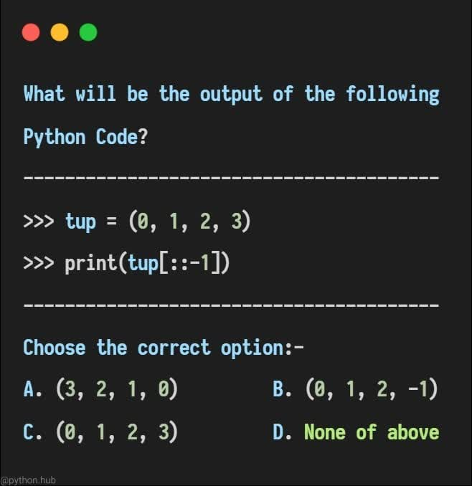

Slide 24
Copying the Whole Sequence
[ : ] makes a copy of an entire sequence
>>> t[:]
(23, ‘abc’, 4.56, (2,3), ‘def’)
Note the difference between these two lines for mutable sequences
>>> l2 = l1 # Both refer to 1 ref,
# changing one affects both
>>> l2 = l1[:] # Independent copies, two refs

Slide 25
The ‘in’ Operator
Boolean test whether a value is inside a container:
>>> t = [1, 2, 4, 5]
>>> 3 in t
False
>>> 4 in t
True
>>> 4 not in t
False
For strings, tests for substrings
>>> a = 'abcde'
>>> 'c' in a
True
>>> 'cd' in a
True
>>> 'ac' in a
False
Be careful: the in keyword is also used in the syntax of for loops and list comprehensions

Slide 26
The + Operator
The + operator produces a new tuple, list, or string whose value is the concatenation of its arguments.
>>> (1, 2, 3) + (4, 5, 6)
(1, 2, 3, 4, 5, 6)
>>> [1, 2, 3] + [4, 5, 6]
[1, 2, 3, 4, 5, 6]
>>> “Hello” + “ ” + “World”
‘Hello World’

Slide 27
The * Operator
The * operator produces a new tuple, list, or string that “repeats” the original content.
>>> (1, 2, 3) * 3
(1, 2, 3, 1, 2, 3, 1, 2, 3)
>>> [1, 2, 3] * 3
[1, 2, 3, 1, 2, 3, 1, 2, 3]
>>> “Hello” * 3
‘HelloHelloHello’

Slide 28
Mutability: Tuples vs. Lists

Slide 29
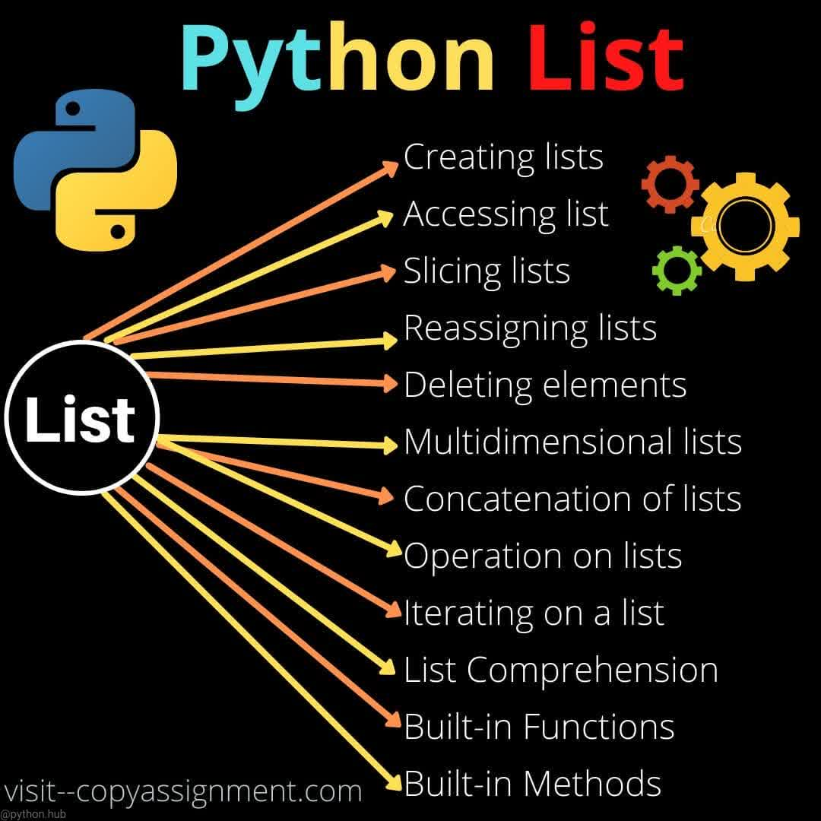

Slide 30
Lists are mutable
>>> li = [‘abc’, 23, 4.34, 23]
>>> li[1] = 45
>>> li [‘abc’, 45, 4.34, 23]
We can change lists in place.
Name li still points to the same memory reference when we’re done.

Slide 31
Tuples are immutable
>>> t = (23, ‘abc’, 4.56, (2,3), ‘def’)
>>> t[2] = 3.14
Traceback (most recent call last):
File "<pyshell#75>", line 1, in -toplevel-
tu[2] = 3.14
TypeError: object doesn't support item assignment
You can’t change a tuple.
You can make a fresh tuple and assign its reference to a previously used name.
>>> t = (23, ‘abc’, 3.14, (2,3), ‘def’)
The immutability of tuples means they’re faster than lists.

Slide 32
Operations on Lists Only
>>> li = [1, 11, 3, 4, 5]
>>> li.append(‘a’) # Note the method syntax
>>> li
[1, 11, 3, 4, 5, ‘a’]
>>> li.insert(2, ‘i’)
>>>li
[1, 11, ‘i’, 3, 4, 5, ‘a’]

Slide 33
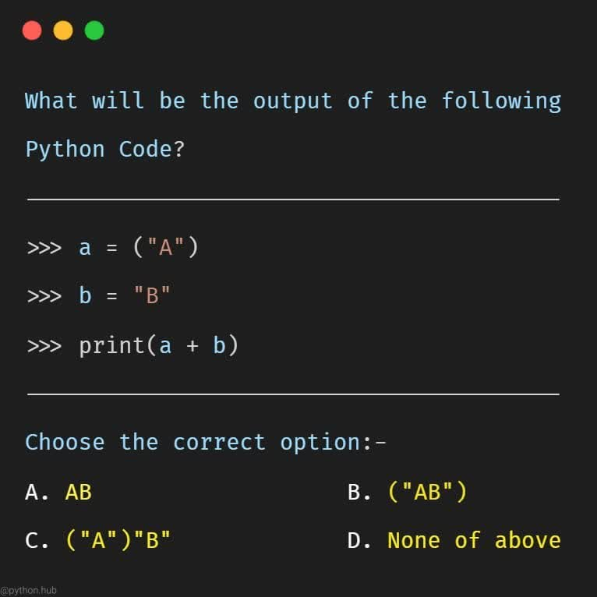
Guess it?

Slide 34
The extend method vs append method
+ creates a fresh list with a new memory ref
extend operates on list li in place.
>>> li.extend([9, 8, 7])
>>> li
[1, 2, ‘i’, 3, 4, 5, ‘a’, 9, 8, 7]
Potentially confusing:
extend takes a list as an argument.
append takes a singleton as an argument.
>>> li.append([10, 11, 12])
>>> li
[1, 2, ‘i’, 3, 4, 5, ‘a’, 9, 8, 7, [10, 11, 12]]

Slide 35
Operations on Lists Only
Lists have many methods, including index, count, remove, reverse, sort
>>> li = [‘a’, ‘b’, ‘c’, ‘b’]
>>> li.index(‘b’) # index of 1st occurrence
1
>>> li.count(‘b’) # number of occurrences
2
>>> li.remove(‘b’) # remove 1st occurrence
>>> li
[‘a’, ‘c’, ‘b’]

Slide 36
Operations on Lists Only
>>> li = [5, 2, 6, 8]
>>> li.reverse() # reverse the list *in place*
>>> li
[8, 6, 2, 5]
>>> li.sort() # sort the list *in place*
>>> li
[2, 5, 6, 8]
>>> li.sort(some_function)
# sort in place using user-defined comparison

Slide 37
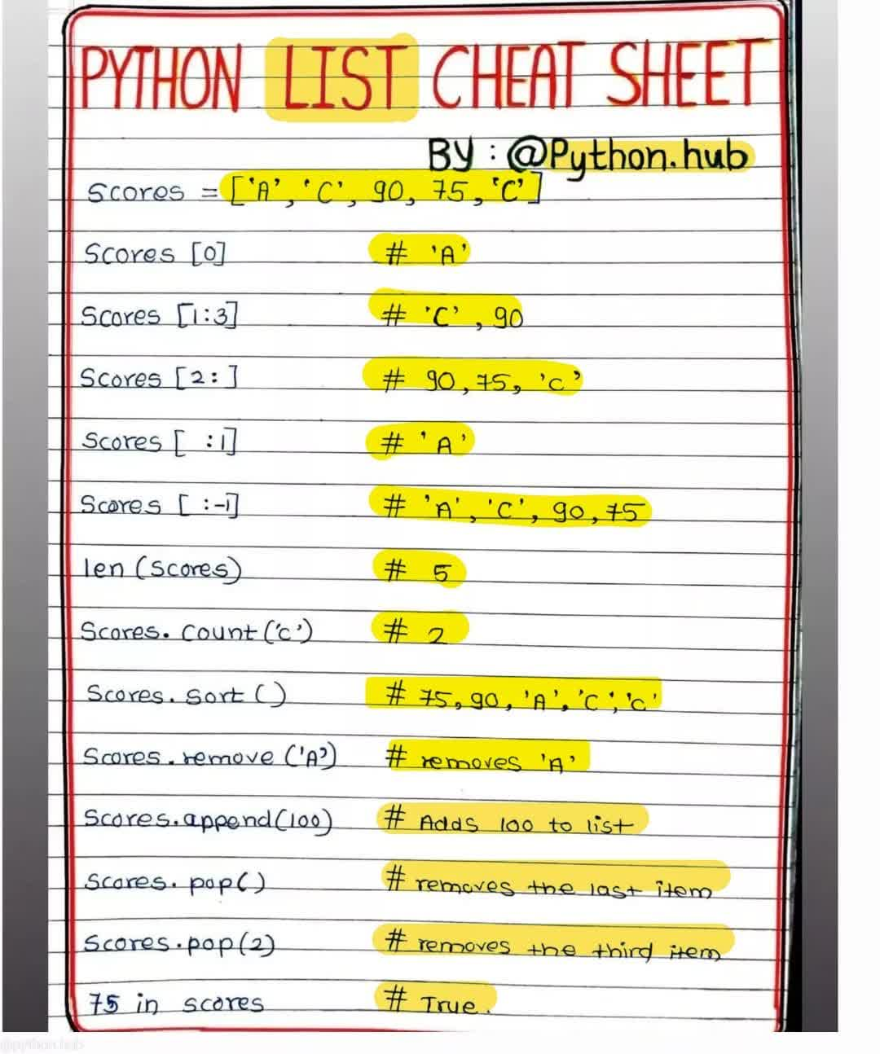

Slide 38
Tuple details
The comma is the tuple creation operator, not parens
>>> 1,
(1,)
Python shows parens for clarity (best practice)
>>> (1,)
(1,)
Don't forget the comma!
>>> (1)
1
Trailing comma only required for singletons others
Empty tuples have a special syntactic form
>>> ()
()
>>> tuple()
()

Slide 39
Summary: Tuples vs. Lists
Lists slower but more powerful than tuples
Lists can be modified, and they have lots of handy operations and mehtods
Tuples are immutable and have fewer features
To convert between tuples and lists use the list() and tuple() functions:
li = list(tu)
tu = tuple(li)

Slide 40
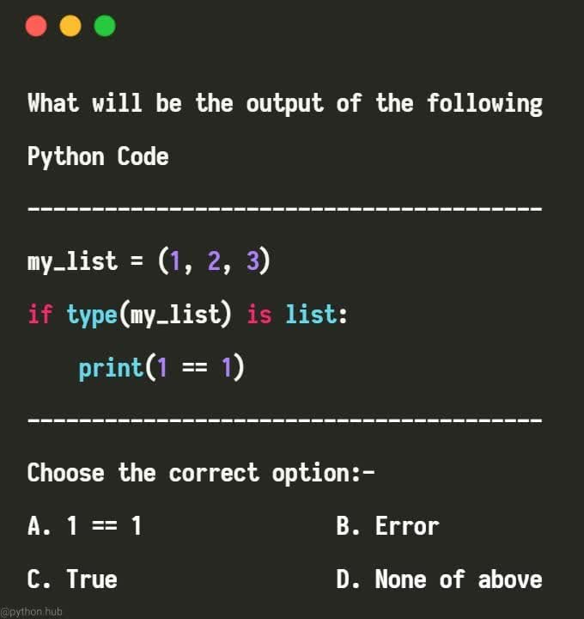

Slide 41
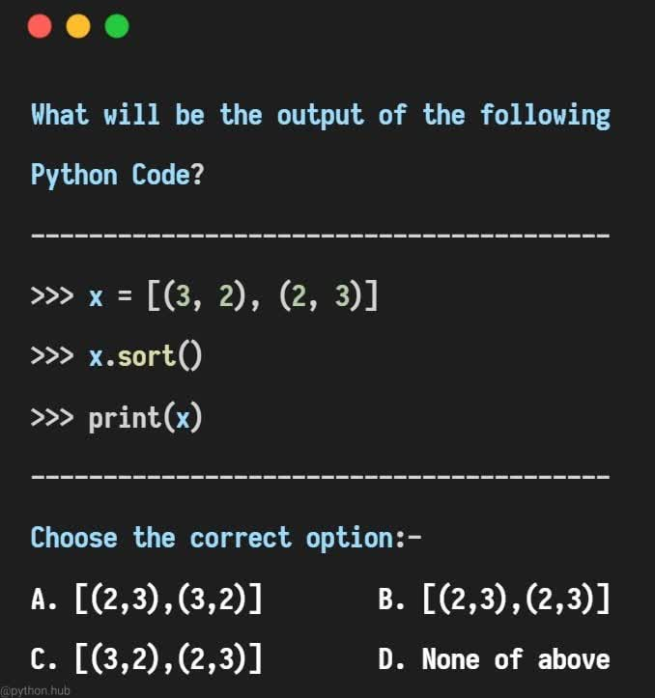

Slide 42
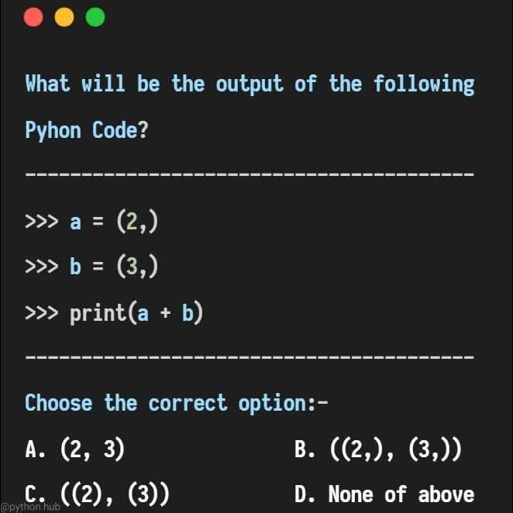

Slide 43
